Slide 1
Fuse & Lab Preparation
c/python

Slide 2
Outlines
FUSE Introduction
FUSE Kernel Module
FUSE Userspace Library
FUSE Library in C – libfuse
FUSE Library in Python - python-fuse

Slide 3
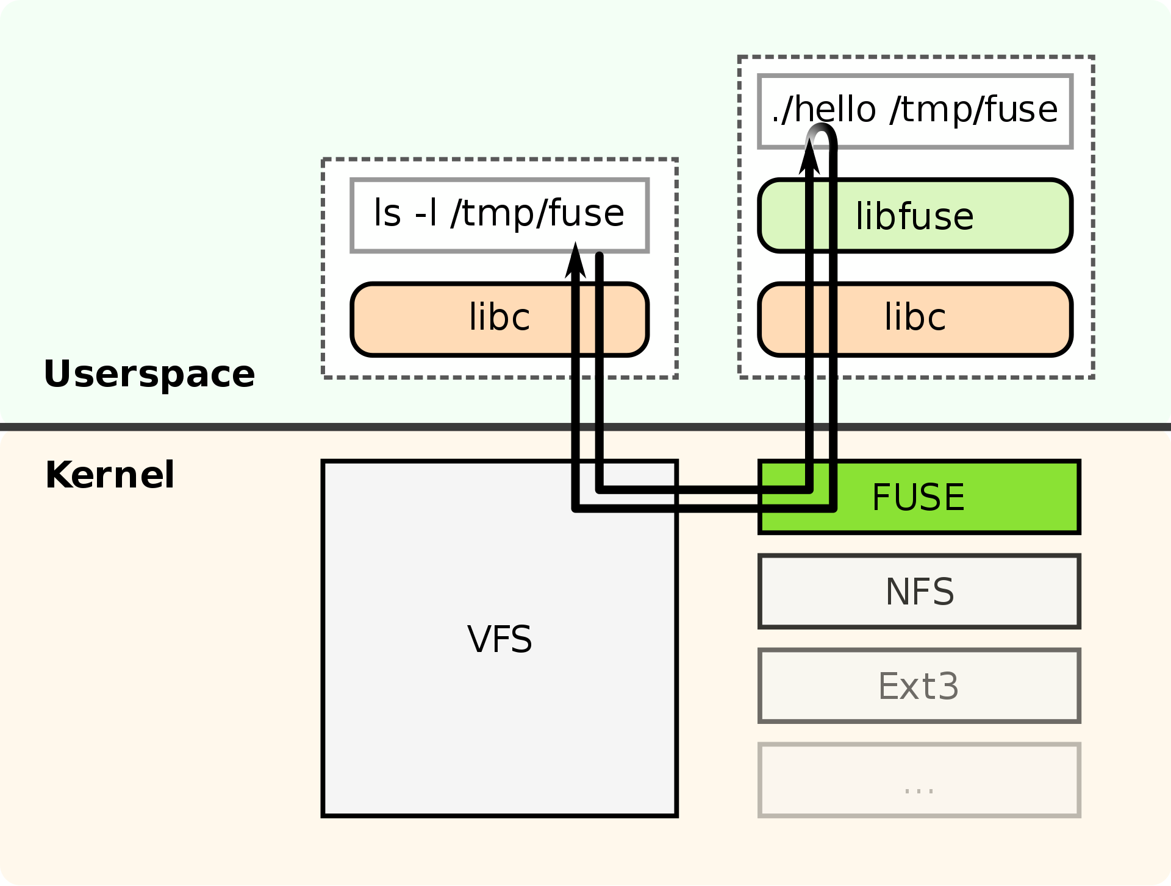
FUSE Introduction
FUSE (Filesystem in Userspace) is an interface for userspace programs to export a filesystem to the Linux kernel.
The FUSE project consists of two components:
the fuse kernel module
and the libfuse userspace library provides the reference implementation for communicating with the FUSE kernel module.

Slide 4
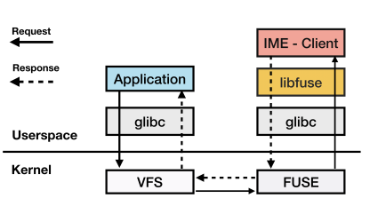
FUSE Introduction
A FUSE file system is typically implemented as a standalone application that links with libfuse.
libfuse provides functions to mount the file system, unmount it, read requests from the kernel, and send responses back.
https://juser.fz-juelich.de/record/892137/files/CHEOPS___IME___SIONlib-ACM_format.pdf

Slide 5
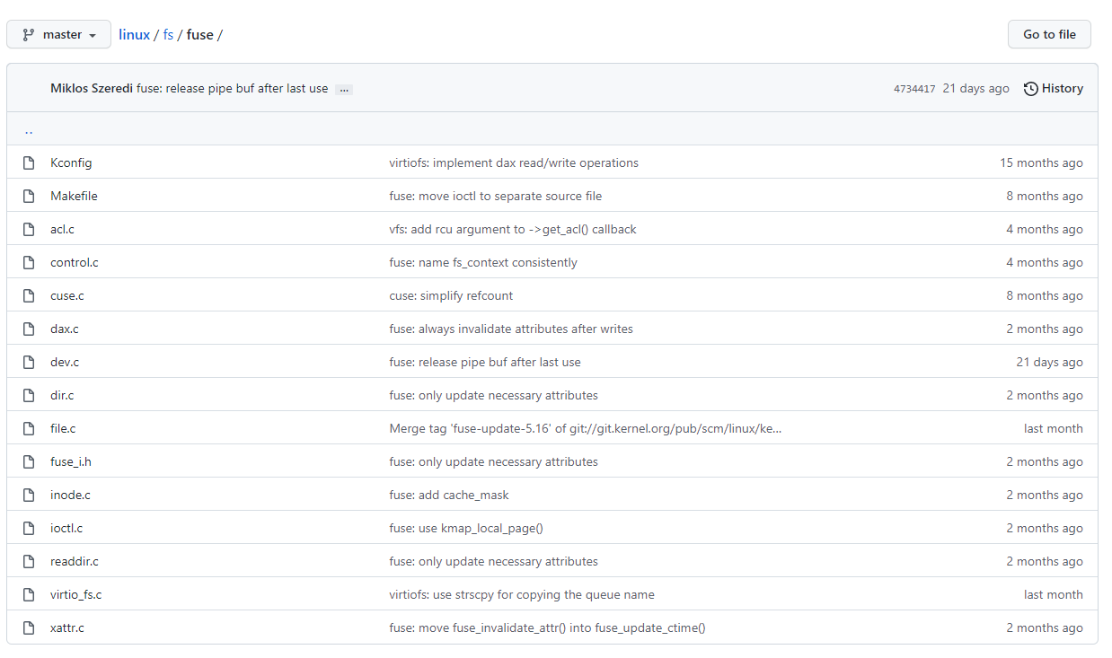
FUSE Kernel Module
FS Definition & Register
static struct file_system_type fuse_fs_type = {
.owner = THIS_MODULE,
.name = "fuse",
.fs_flags = FS_HAS_SUBTYPE | FS_USERNS_MOUNT,
.init_fs_context = fuse_init_fs_context,
.parameters = fuse_fs_parameters,
.kill_sb = fuse_kill_sb_anon,
};
static int __init fuse_fs_init(void)
{
…
err = register_filesystem(&fuse_fs_type);
…
}
https://github.com/torvalds/linux/blob/master/fs/fuse/inode.c

Slide 6
FUSE Userspace Library
Library Name | Programing Language | Github
libfuse | C | https://github.com/libfuse/libfuse
python-fuse | Python | https://github.com/libfuse/python-fuse
go-fuse | Go | https://github.com/hanwen/go-fuse
fuserl | Erlang | https://github.com/tonyrog/fuserl
jnr-fuse | Jave | https://github.com/SerCeMan/jnr-fuse

Slide 7
FUSE Library in C
- libfuse

Slide 8
FUSE Library in C - libfuse
libfuse offers two APIs:
a "high-level“:
synchronous API
the callbacks may work with file names and paths instead of inodes
and processing of a request finishes when the callback function returns
a "low-level“:
asynchronous API
the callbacks must work with inodes
and responses must be sent explicitly using a separate set of API functions

Slide 9
libfuse: High-level & Low-level APIs
"high-level“ Operations
“low-level“ Operations
/**
* The file system operations:
…
struct fuse_operations {
…
int (*getattr) (const char *, struct stat *, struct fuse_file_info *fi);
…
int (*open) (const char *, struct fuse_file_info *);
…
int (*read) (const char *, char *, size_t, off_t, struct fuse_file_info *);
…
/**
* Low level filesystem operations
…
struct fuse_lowlevel_ops {
…
void (*getattr) (fuse_req_t req, fuse_ino_t ino, struct fuse_file_info *fi);
…
void (*open) (fuse_req_t, fuse_ino_t, struct fuse_file_info *);
…
void (*read) (fuse_req_t, fuse_ino_t, size_t, off_t, struct fuse_file_info *);
…
https://github.com/libfuse/libfuse/blob/master/include/fuse.h
https://github.com/libfuse/libfuse/blob/master/include/fuse_lowlevel.h

Slide 10
libfuse: High-level & Low-level APIs
"high-level“
“low-level“
static int hello_getattr(const char *path,
struct stat *stbuf, struct fuse_file_info *fi)
{
(void) fi;
int res = 0;
memset(stbuf, 0, sizeof(struct stat));
if (strcmp(path, "/") == 0) {
stbuf->st_mode = S_IFDIR | 0755;
stbuf->st_nlink = 2;
} else if (strcmp(path+1, options.filename) == 0) {
stbuf->st_mode = S_IFREG | 0444;
stbuf->st_nlink = 1;
stbuf->st_size = strlen(options.contents);
} else
res = -ENOENT;
return res;
}
static void hello_ll_getattr(fuse_req_t req, fuse_ino_t ino, struct fuse_file_info *fi)
{
struct stat stbuf;
(void) fi;
memset(&stbuf, 0, sizeof(stbuf));
if (hello_stat(ino, &stbuf) == -1)
fuse_reply_err(req, ENOENT);
else
fuse_reply_attr(req, &stbuf, 1.0);
}
https://github.com/libfuse/libfuse/blob/master/example/hello.c
https://github.com/libfuse/libfuse/blob/master/example/hello_ll.c

Slide 11
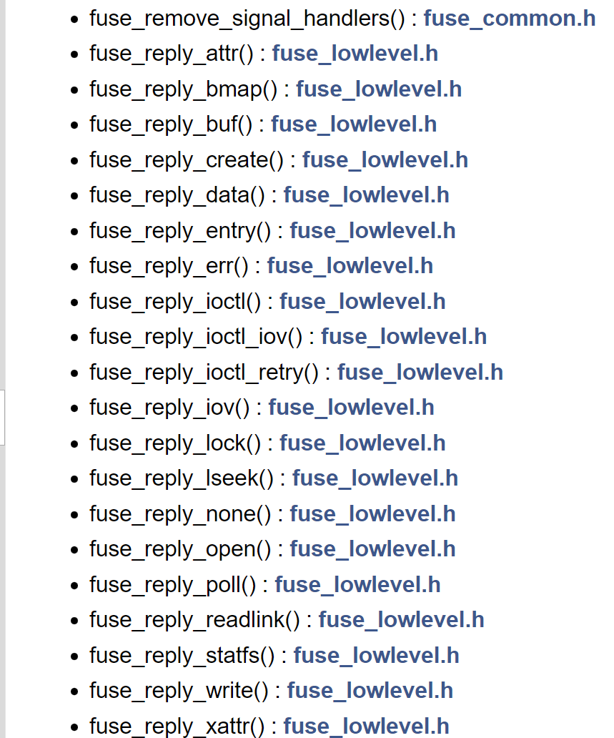
libfuse: Facilitate Functions
“low-level“
static void hello_ll_getattr(fuse_req_t req, fuse_ino_t ino, struct fuse_file_info *fi)
{
struct stat stbuf;
(void) fi;
memset(&stbuf, 0, sizeof(stbuf));
if (hello_stat(ino, &stbuf) == -1)
fuse_reply_err(req, ENOENT);
else
fuse_reply_attr(req, &stbuf, 1.0);
}
http://libfuse.github.io/doxygen/globals_func.html

Slide 12
libfuse: High-level Calls Low-level APIs
Binding Default callback functions
High-level Operations
Low-level Operations
static struct fuse_lowlevel_ops fuse_path_ops = {
…
.getattr = fuse_lib_getattr,
.setattr = fuse_lib_setattr,
…
.open = fuse_lib_open,
.read = fuse_lib_read,
…
};
https://github.com/libfuse/libfuse/blob/master/lib/fuse.c#L4459

Slide 13
libfuse: Main-flow for High-level FS
Codes main flow for one simple High-level FS:
Define custom callbacks: fuse_operations
Parse Input Arguments: fuse_opt_parse
Invocate fuse_main
Main function of FUSE.
This is for the lazy. This is all that has to be called from the main() function.
This function does the following:
parses command line options, and handles --help and --version
installs signal handlers for INT, HUP, TERM and PIPE
registers an exit handler to unmount the filesystem on program exit
creates a fuse handle
registers the operations
calls either the single-threaded or the multi-threaded event loop

Slide 14
libfuse: High-level hello
Minimal example filesystem using high-level API
Codes Go-through: https://github.com/libfuse/libfuse/blob/master/example/hello.c
Demos (on an Ubuntu VM)
sudo apt update
sudo apt install libfuse-dev

Slide 15
libfuse: Low-level hello_ll
Minimal example filesystem using low-level API
Codes Go-through: https://github.com/libfuse/libfuse/blob/master/example/hello_ll.c
Demos (on an Ubuntu VM)
sudo apt update
sudo apt install libfuse-dev

Slide 16
FUSE Library in Python
- python-fuse

Slide 17
FUSE Library in Python - python-fuse
Some Options in Python3
Option 1: fuse-python (Recommended)
https://github.com/libfuse/python-fuse
Option 2: pyfuse
https://github.com/nrclark/pyfuse
Option 3: pyfilesystem2 + fusefs
https://pypi.org/project/fusefs/
https://github.com/mirekys/fusefs
https://pypi.org/project/fs/2.4.11/
https://github.com/PyFilesystem/pyfilesystem2
Others
Python2 only https://github.com/libfuse/python-fuse

Slide 18
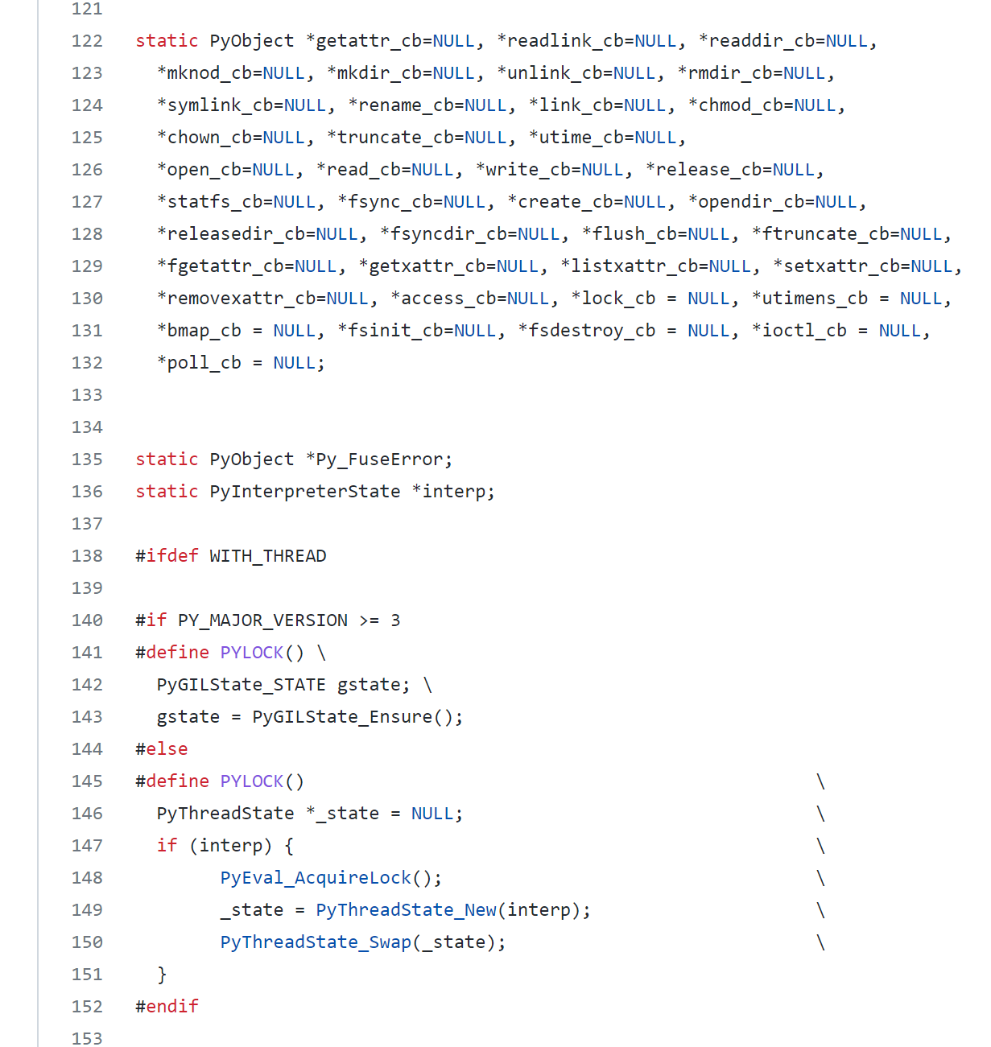
FUSE Library in Python - python-fuse
Python C Extension Interface
https://github.com/libfuse/python-fuse/blob/master/fuseparts/_fusemodule.c

Slide 19
References
https://github.com/libfuse/libfuse
https://en.wikipedia.org/wiki/Filesystem_in_Userspace
https://github.com/libfuse/python-fuse

